Slide 1
EDA for USA election
Bartosz Sawicki
Hubert Ruczyński

Slide 2



Slide 3
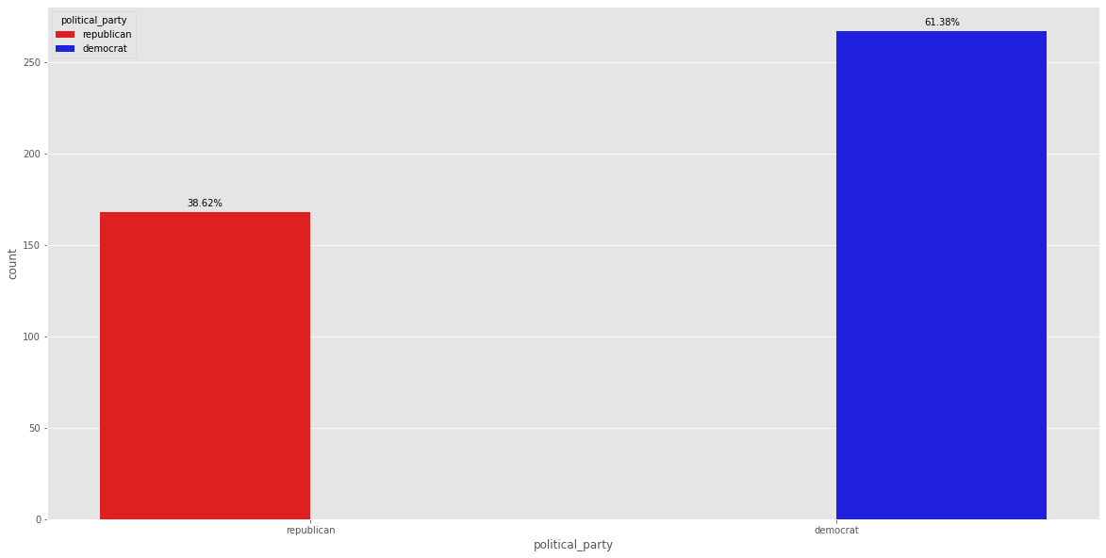

Slide 4
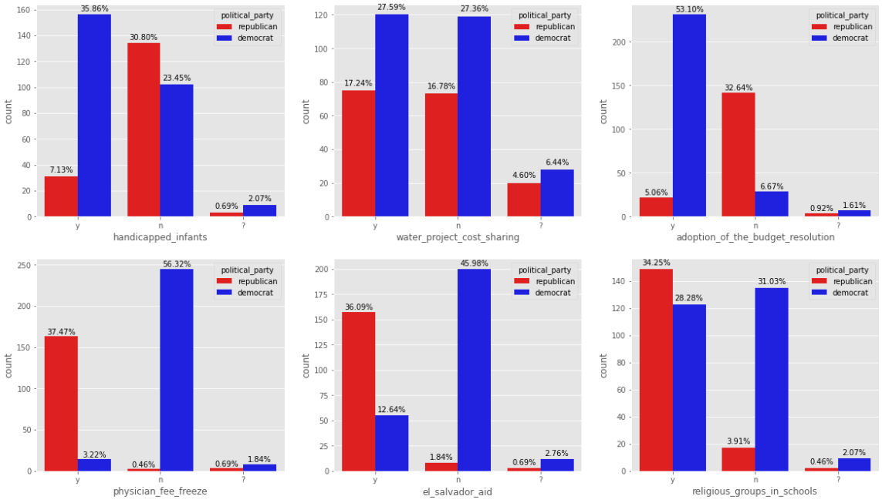

Slide 5
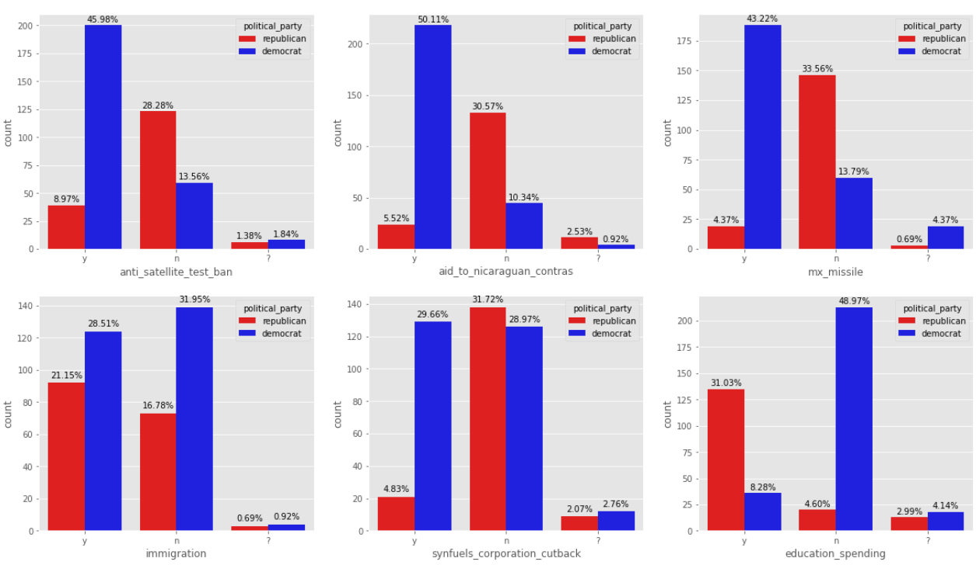

Slide 6



Slide 7



Slide 8
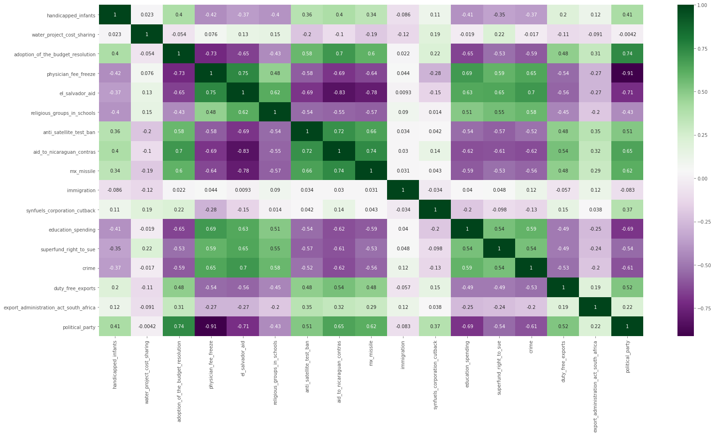

Slide 9


